Slide 1
PMOD2BNC
ArtyS7 Peripheral PCB Design

Slide 2

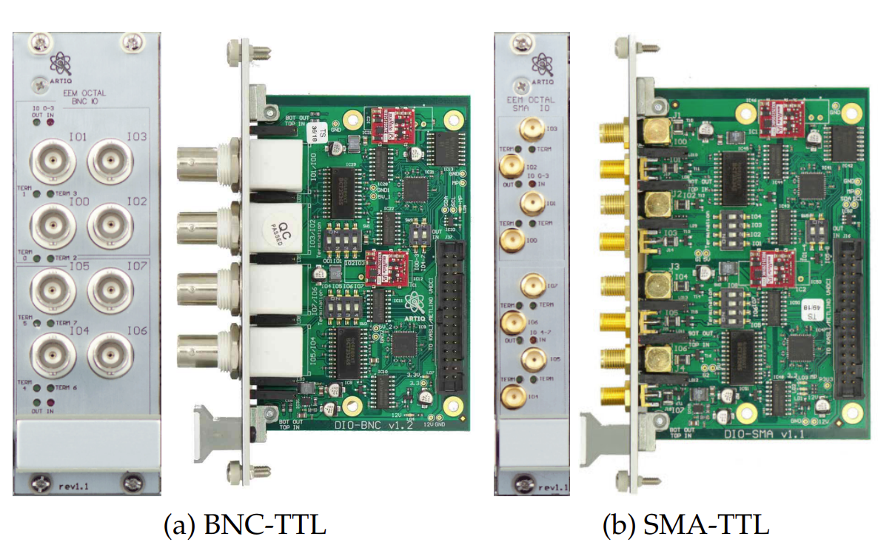
Used Tools & Referenced Board
Cadence Orcad 16.6
M-labs TTL board

Slide 3
Comparision With ARTIQ
 | QuIQCL | M-labs
IO impedance | 50/High Z Selectable | 50/High Z Selectable
Output Voltage | 3.3/5 V Selectable | 5V
Minimum Pulse Width | ~150Mbps | ~3ns
Supply Voltage | 3.3V from FPGA 12V from External | 12V from FPGA(Kasli)
Output Port Type | BNC | BNC or SMA
Isolation | Yes | Yes
IC Controll | No | Yes

Slide 4
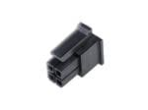
Simplified Architecture
SPDT
Voltage Select
5V
Isolator
3.3V
molex pin
BNC
Isolator
Transceiver
ESD
50 Ohm

Slide 5
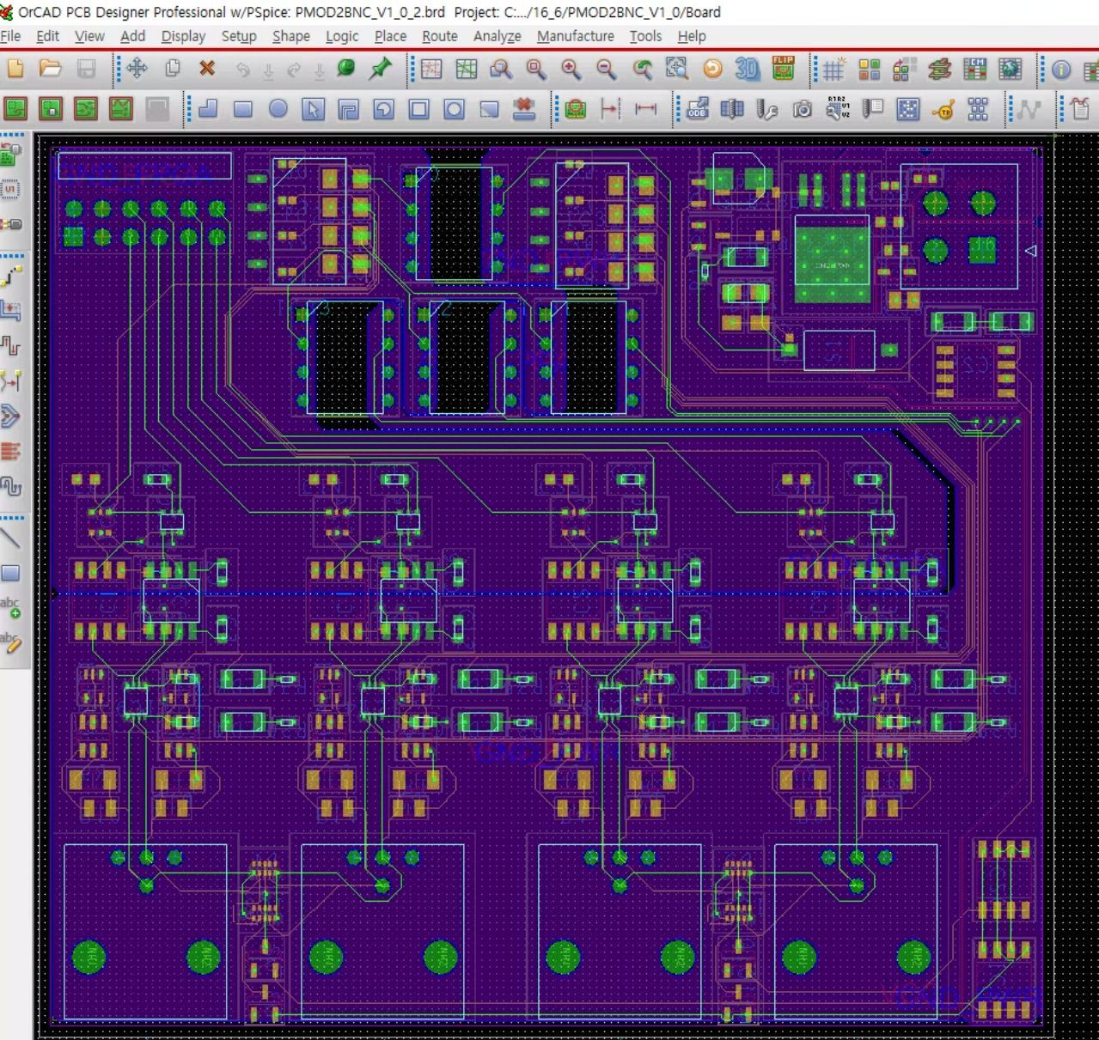
Current Progress

Slide 6
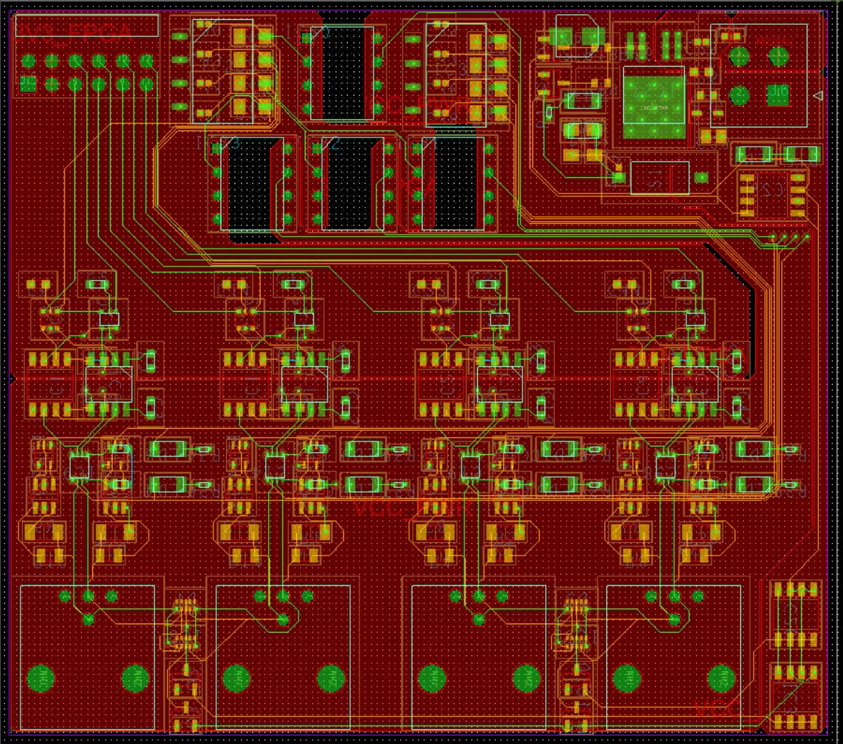
VCC Separation due to Current

Slide 7
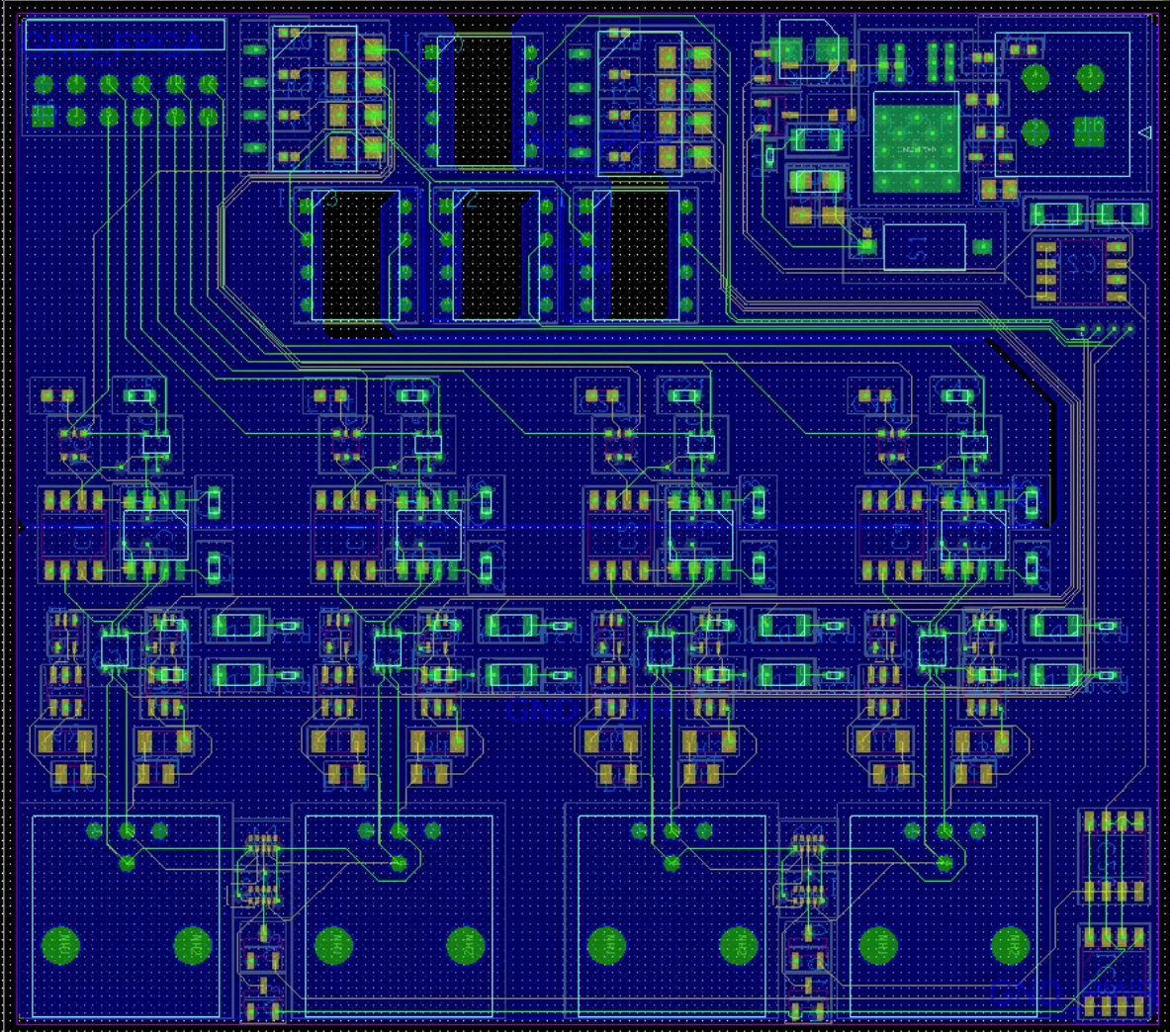
GND Seperation

Slide 8
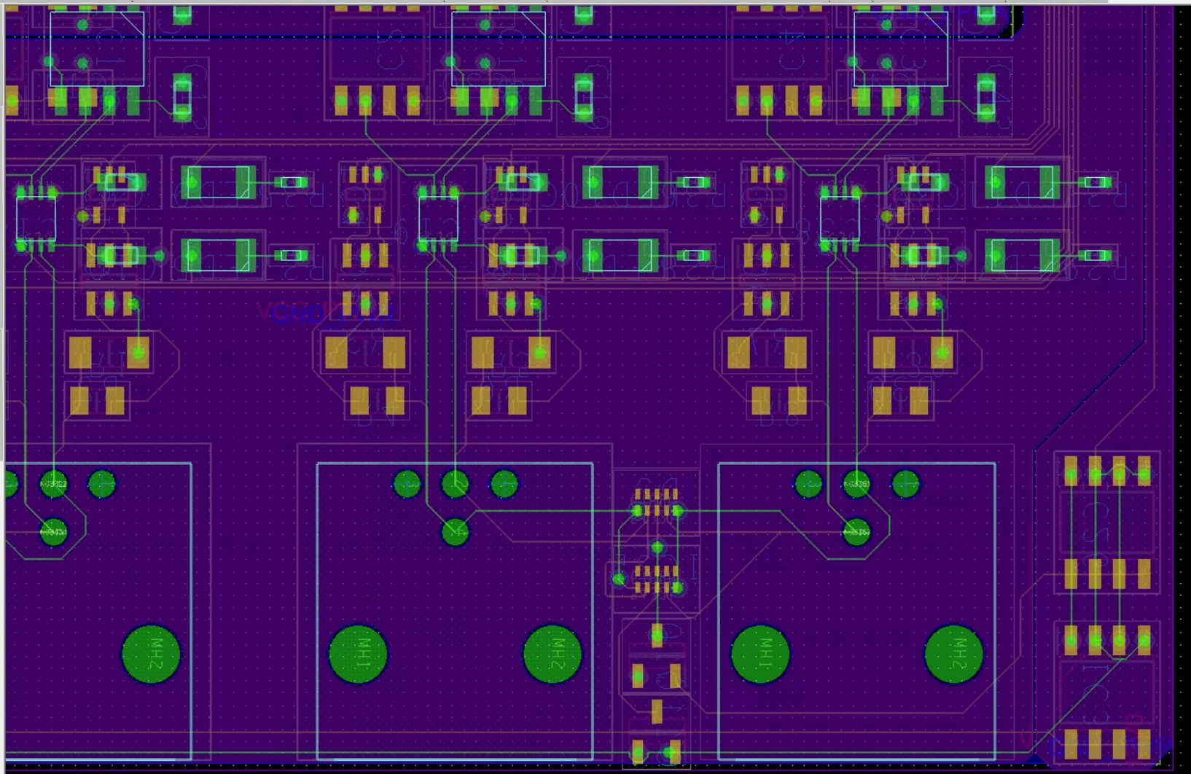
Termination

Slide 9
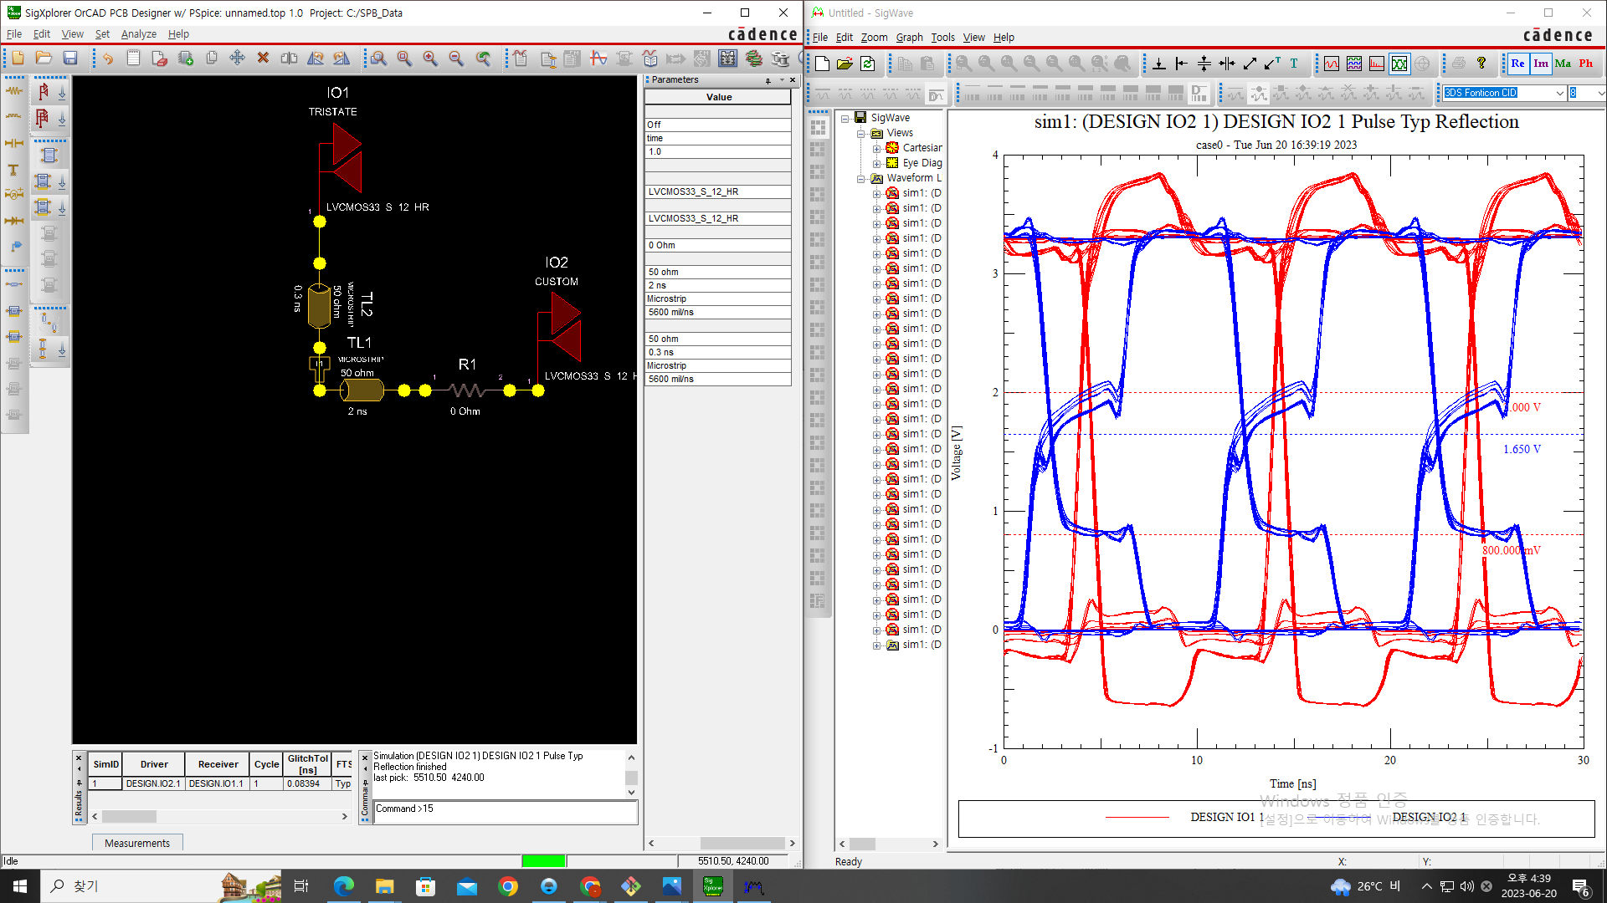
Without Termination

Slide 10
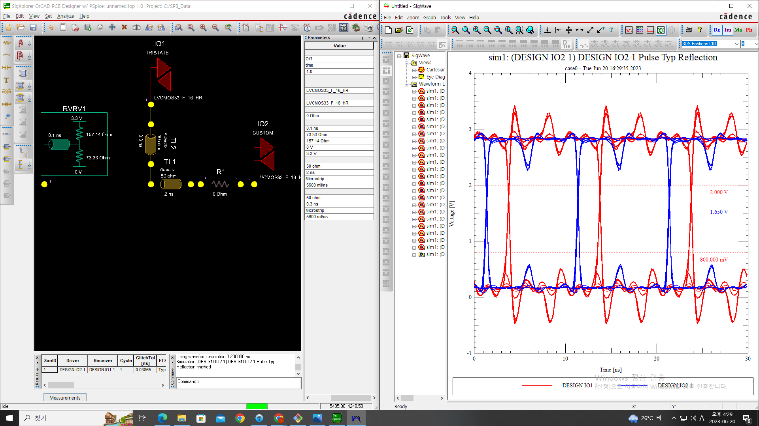
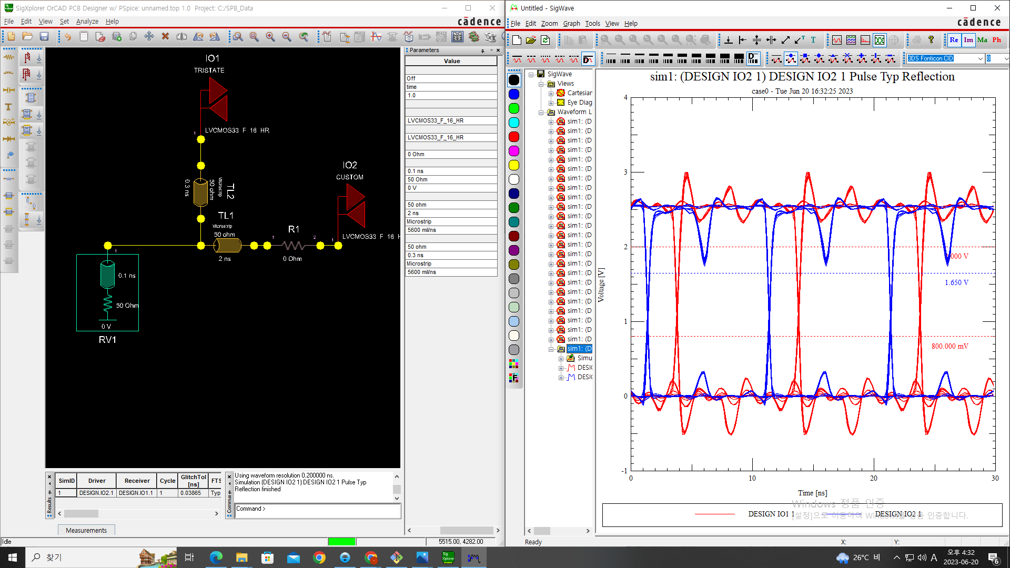
With Termination
Thevnin Termination
Parallel Termination

Slide 11
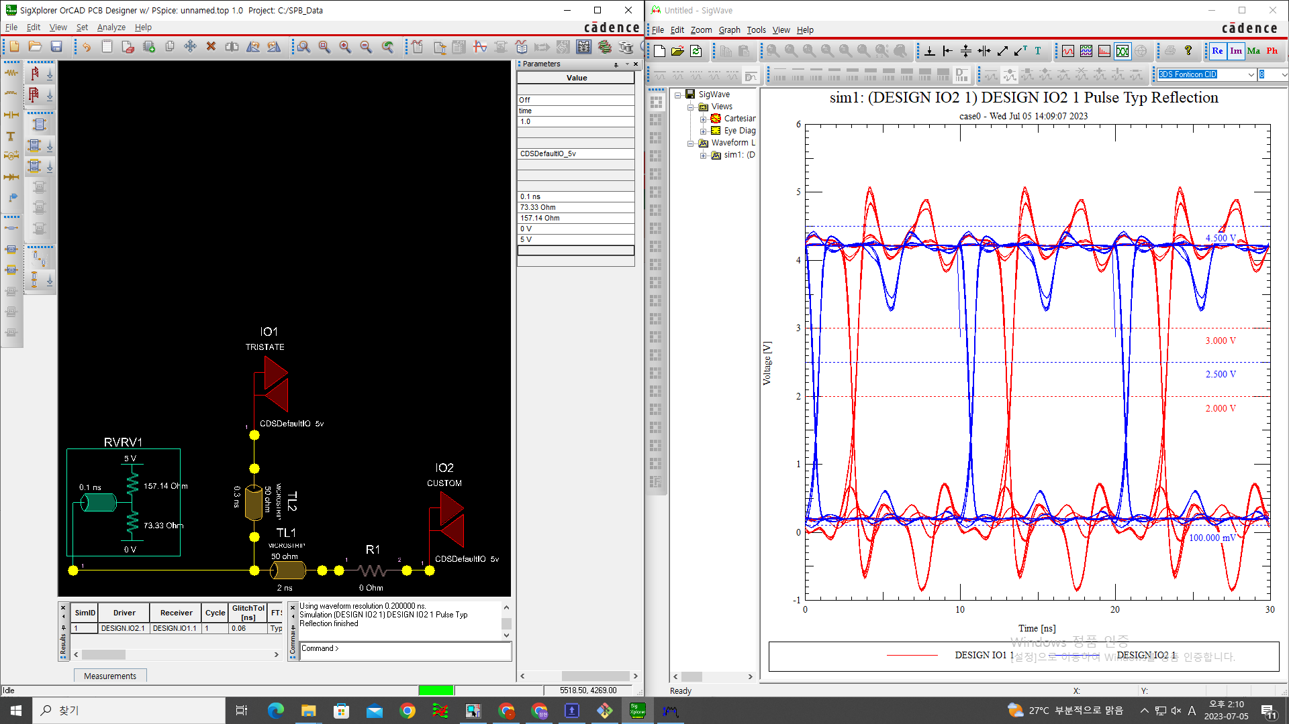
3.3V, 5V comparision
3.3V Thevnin Termination
5V Thevnin Termination

Slide 12
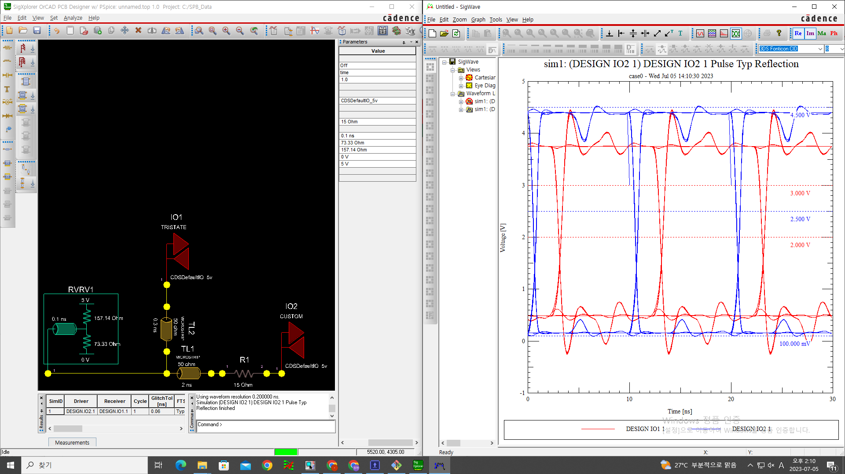
Source Impedance Comparision
w/o source impedance
w/ 15Ohm source impedance

Slide 13
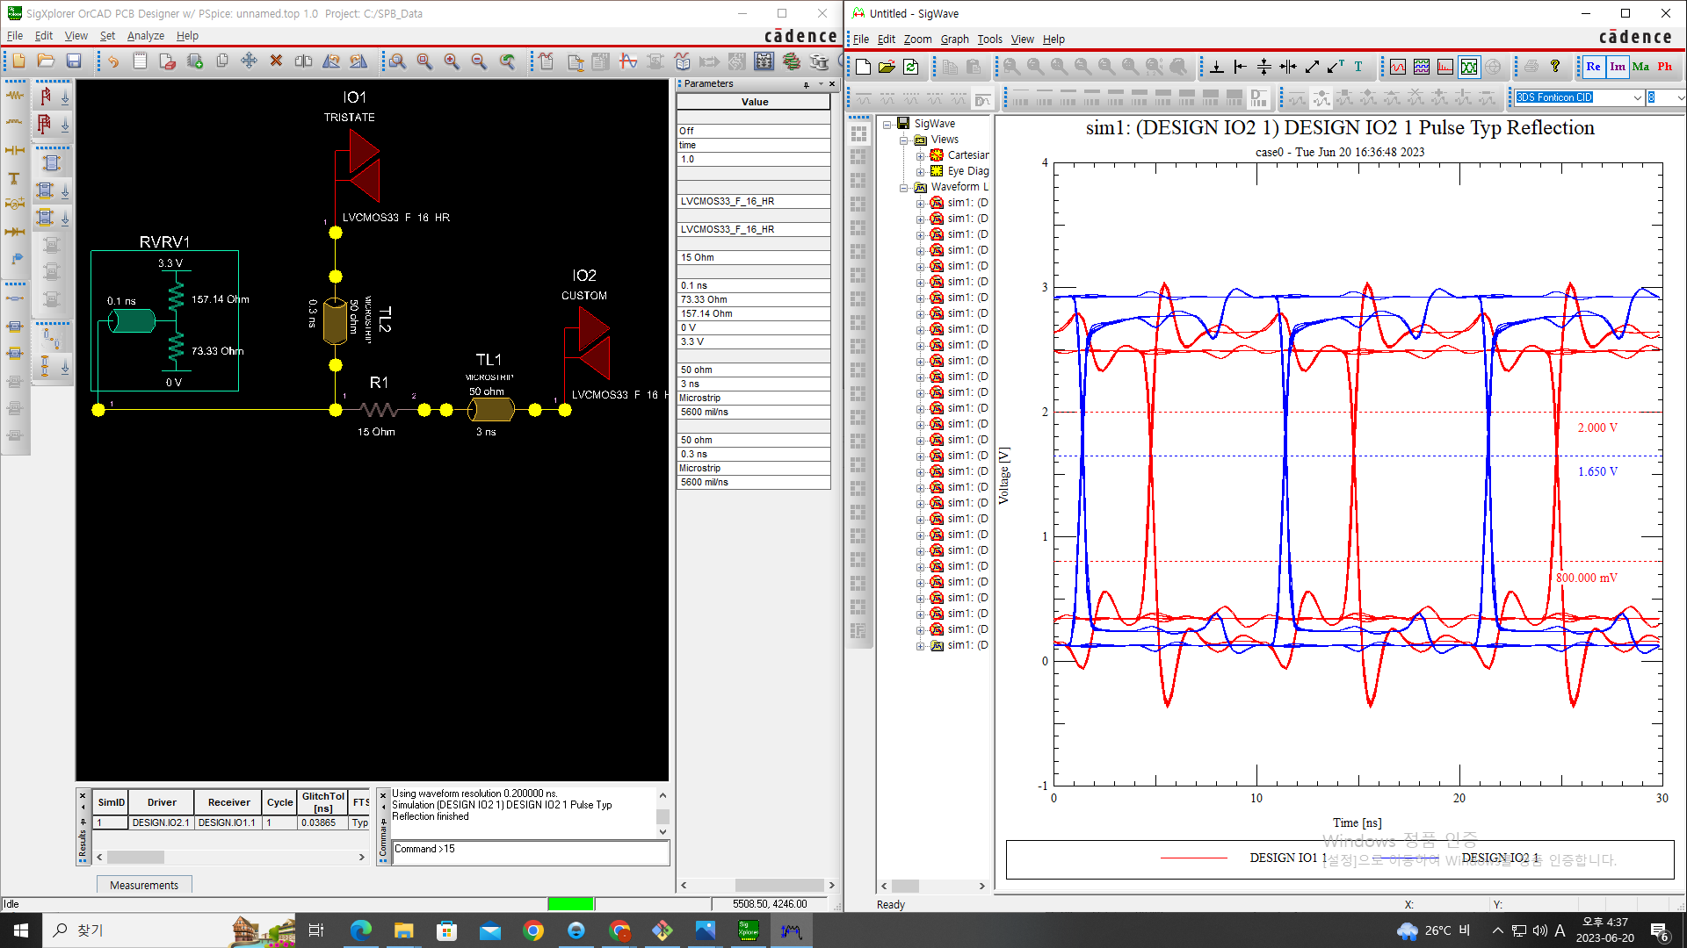
Source Impedance Comparision

Slide 14
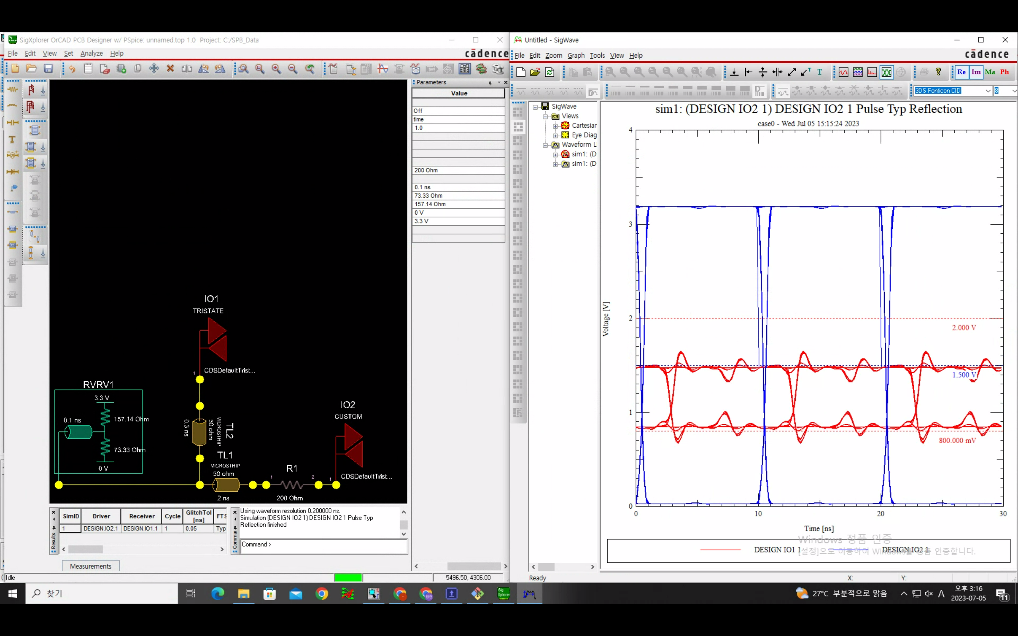
200Ohm

Slide 15
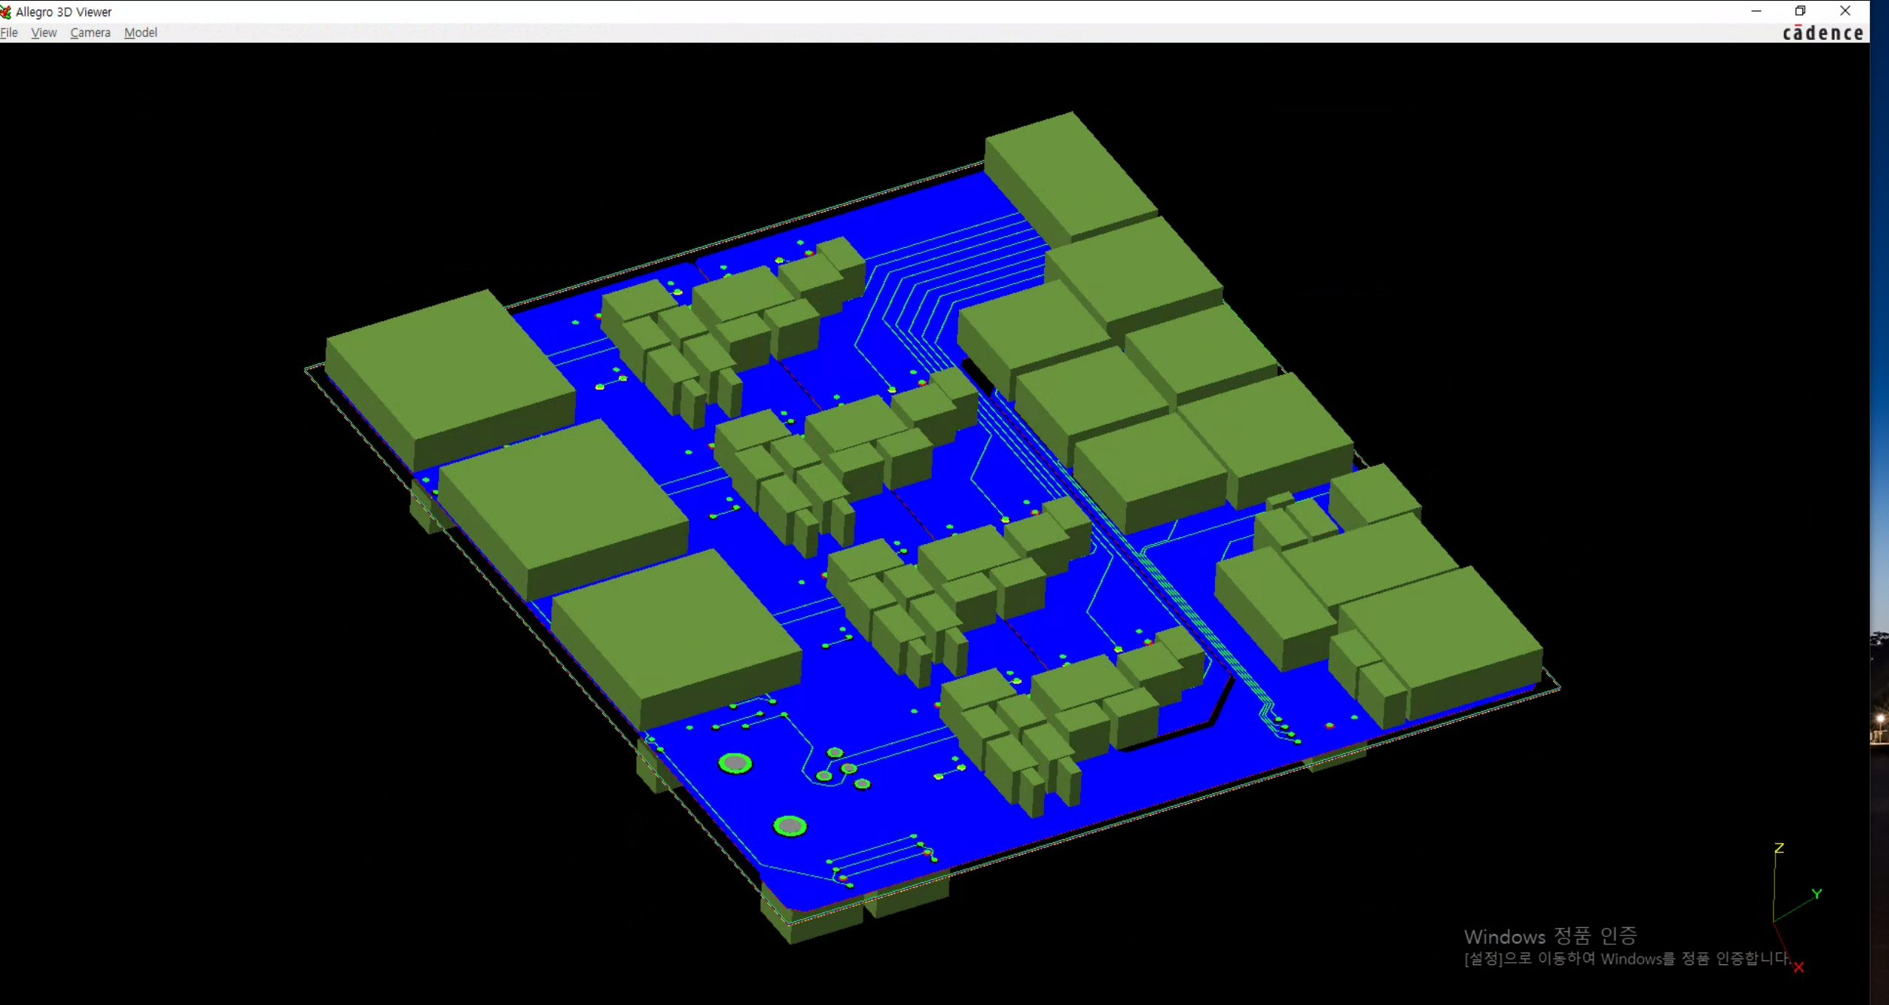
In 3D

Slide 16
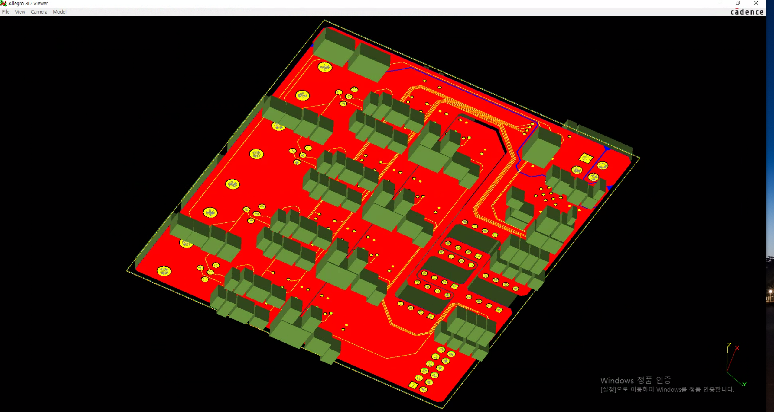
In 3D

Slide 17
ToDo
Delay tuning
PCB thickness setting

Slide 18
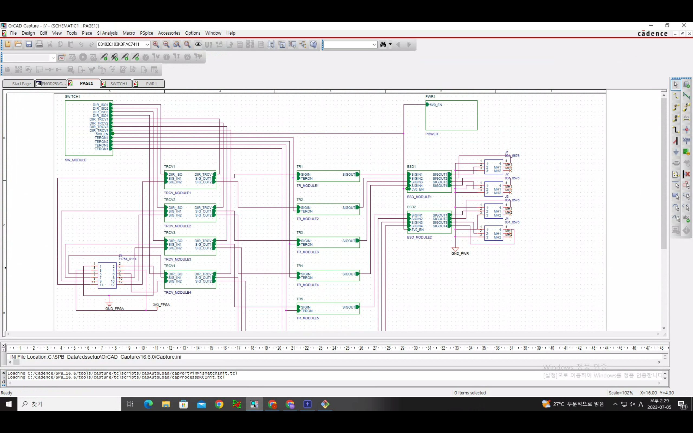

Slide 19
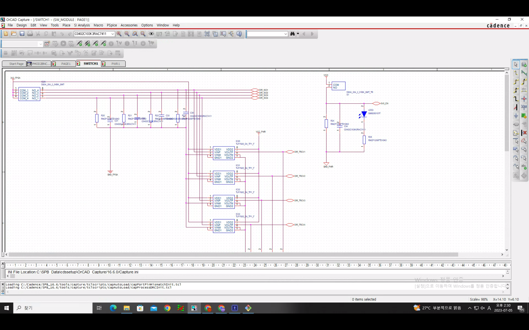

Slide 20
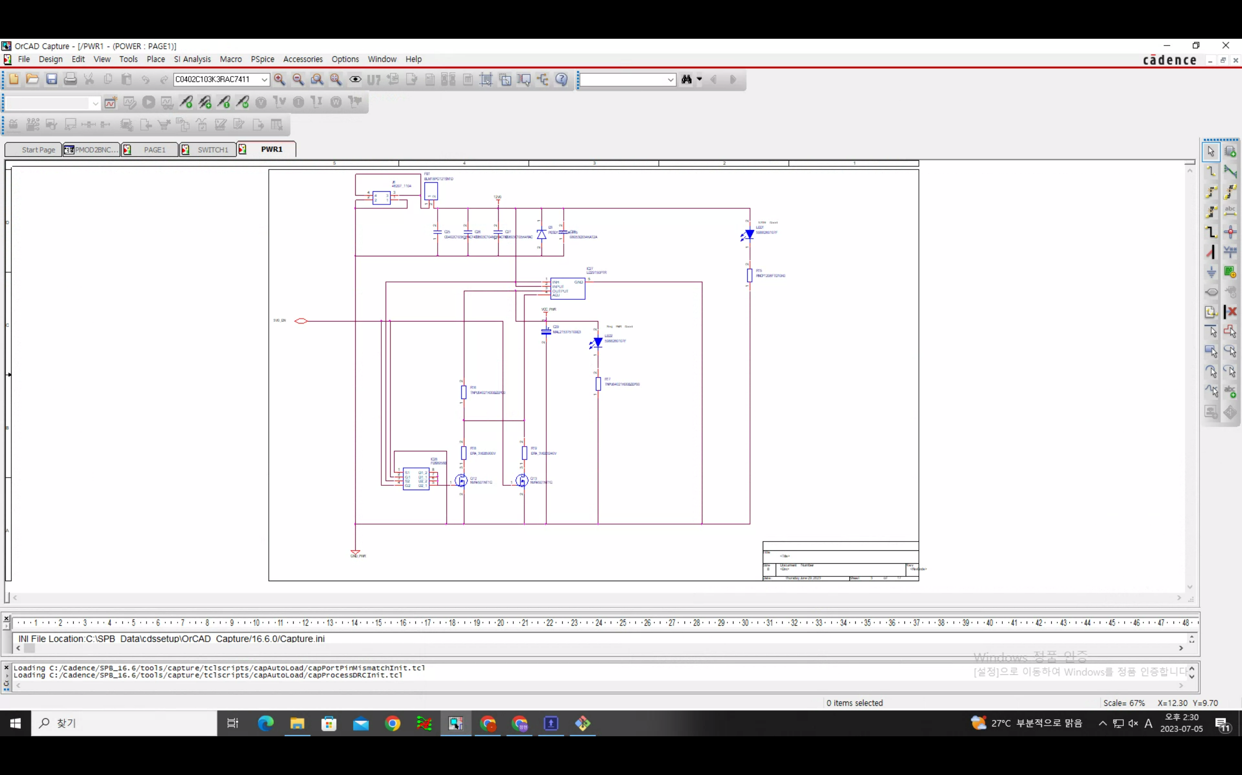

Slide 21
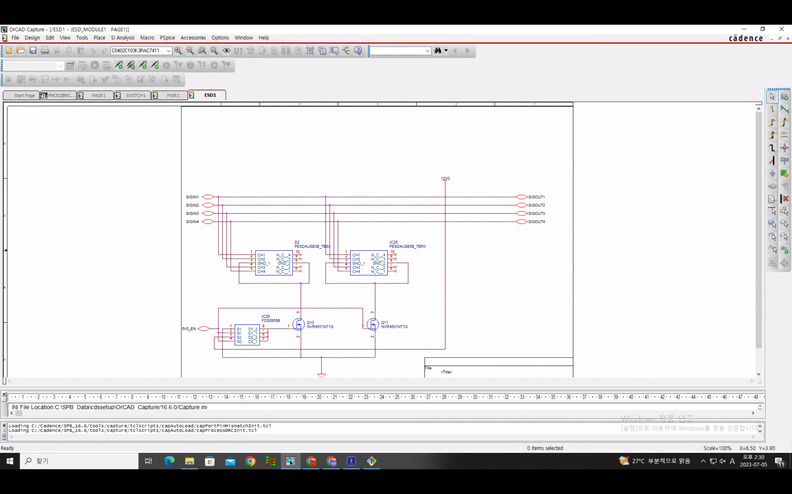

Slide 22
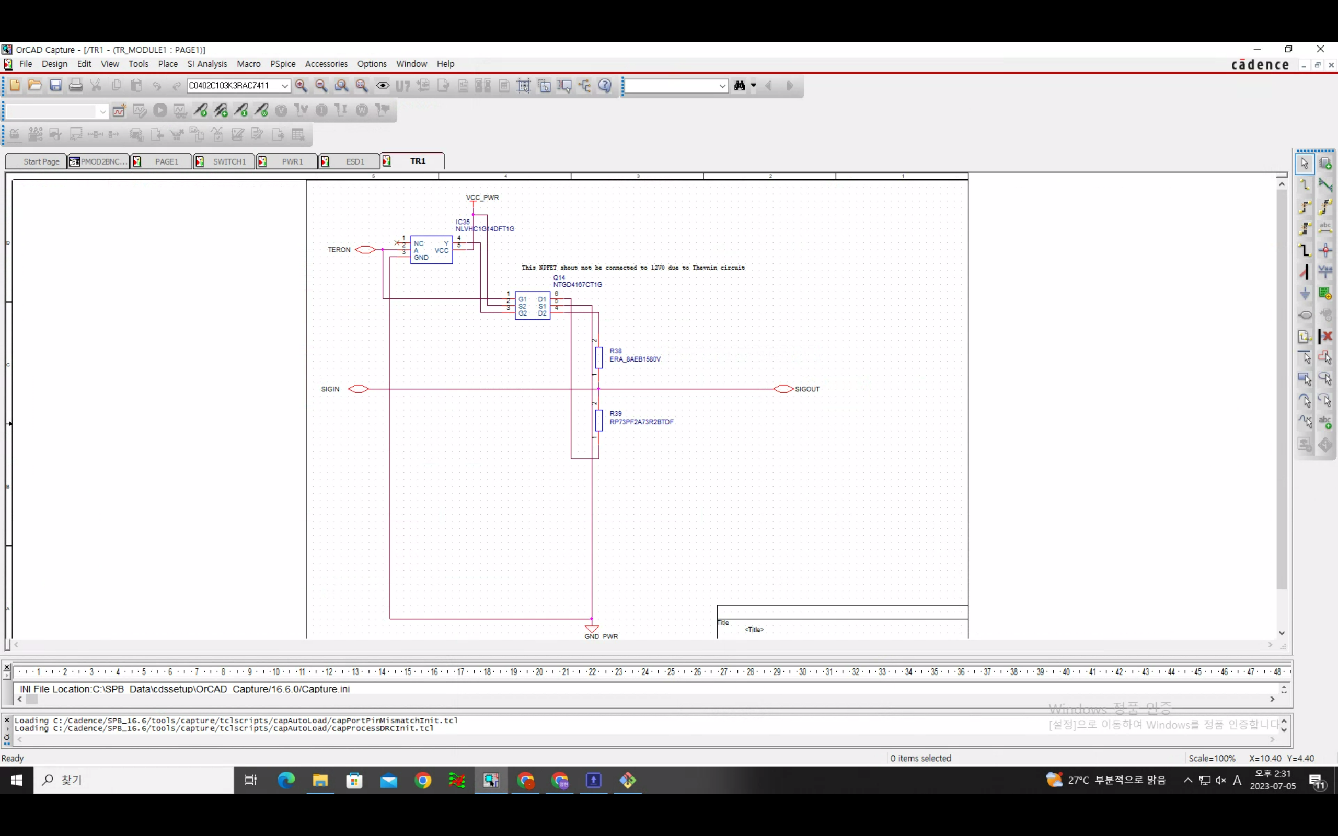

Slide 23
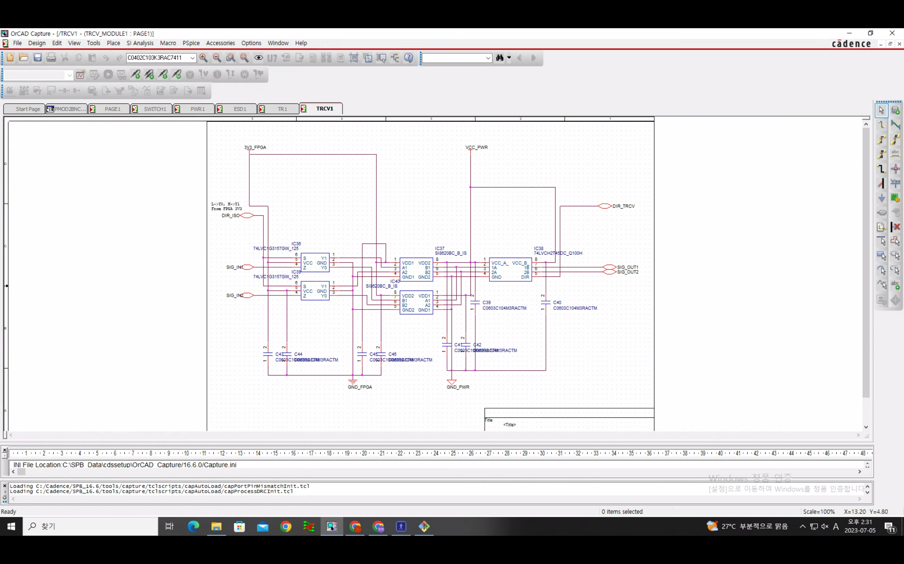

Slide 24
Rev 3
Regulator 12V0 TO 3V3
(LD29150DT33R)
Regulator 12V0 TO 5V0
(LD29150DT50R)
Voltage
Switch
EXT PWR PIN
(462071104)
LED Diode
(598-8260-107F)
LED Diode
(598-8260-107F)
12V0 ESD
(PE3212M1Q_R1_00001)
X2
2.2+5.3+3.1+8.8
=19.4mA, 150mW
NFET
(NVR4501NT1G)
IO SPDT
Impedance SPDT
Ground Isolation
3V3 ESD
(UCLAMP3301H.TCT)
5V0 ESD
(PRTR5V0U2X,215)
3.3V Source
Isolator
2->2
(SI8620BC-B-IS)
Transciever
2<->2
(74LVCH2T45DC-Q100H)
100mA, 250mW
Transistor
(LIB_NTGD4167CT1G)
Digital SPDT
(74LVC1G3157GW,125)
Isolator
2->2
(SI8620BC-B-IS)
157.14Ohm
(ERA-8AEB1580V)
Molex
Pin Header
(71764-0112)
50Ohm
BNC
(031-6575)
Transciever
2<->2
(74LVCH2T45DC-Q100H)
Digital SPDT
(74LVC1G3157GW,125)
Isolator
2<-2
(SI8620BC-B-IS)
73.33Ohm
(RP73PF2A73R2BTDF)
Invertor
(NLVHC1G14DFT1G)
Transistor
(LIB_NTGD4167CT1G)
Isolator
2<-2
(SI8620BC-B-IS)

Slide 25
SPDT Structure
SPDT
(DS04-254-2-04BK-SMT)
X4
10KOhm
(RNCP1206FTD10K0)
100nF
(MSRLJ103SB5104MFNA01)

Slide 26
LED
1KOhm
(RNCP1206FTD1K00)
LED Diode
(598-8260-107F)

Slide 27
Voltage Switch
PFET
(NTR3A052PZT1G)
Switch
(DS04-254-2-01BK-SMT-TR)
Invertor
(NLVHC1G14DFT1G)
PFET
(NTR3A052PZT1G)
10KOhm
(RNCP1206FTD10K0)
100nF
(MSRLJ103SB5104MFNA01)

Slide 28
Decoupling Capacitor (@ IC VCC pin)
10uF (Electro)
(MAL215375109E3)
Sizes should considered!!! in 100 nF (8501 ... etc)
Look : https://www.renesas.com/us/en/document/apn/an1325-choosing-and-using-bypass-capacitors
-> L effect considered
1uF (Ceramic)
(KAM03CT70J105KH)
100nF (Ceramic)
(MSRLJ103SB5104MFNA01)
10nF (Ceramic)
(MAASL063SB7103MFCA01)

Slide 29
Bypass Capacitor (@ power source)
1nH(Ferrite Bead)
(BLM18PG121SN1D)
1uF (Ceramic)
(KAM03CT70J105KH)
100nF (Ceramic)
(MSRLJ103SB5104MFNA01)
10nF (Ceramic)
(MAASL063SB7103MFCA01)

